Slide 1
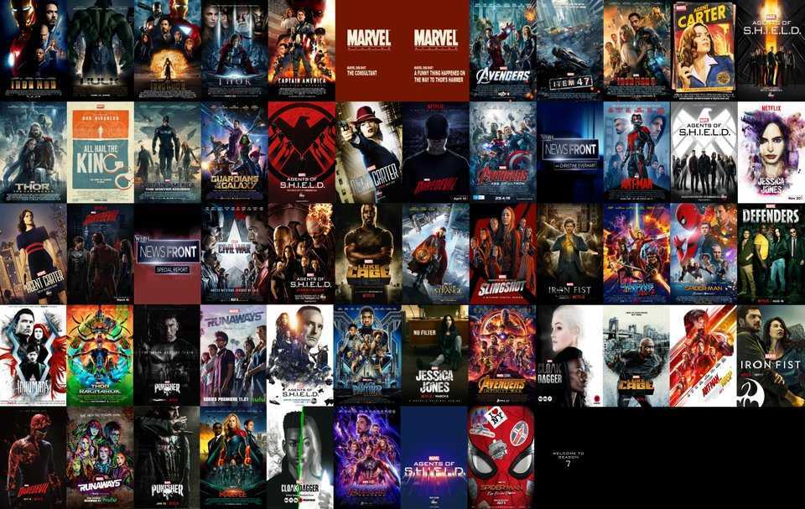
Posters Web App
By Hagai Kraus

Slide 2

Project Description:
This project uses a web browser to download a chosen movie poster,
the program first start looking at a designated MongoDB if the poster is not found there,
The software tries to download it from IMDB through API request using API key,
after downloading the poster from IMDB to the local computer the poster is inserted to MongoDB,
so the next time the very same poster will be requested it will be retrieved from MongoDB,
which will be faster.

Slide 3
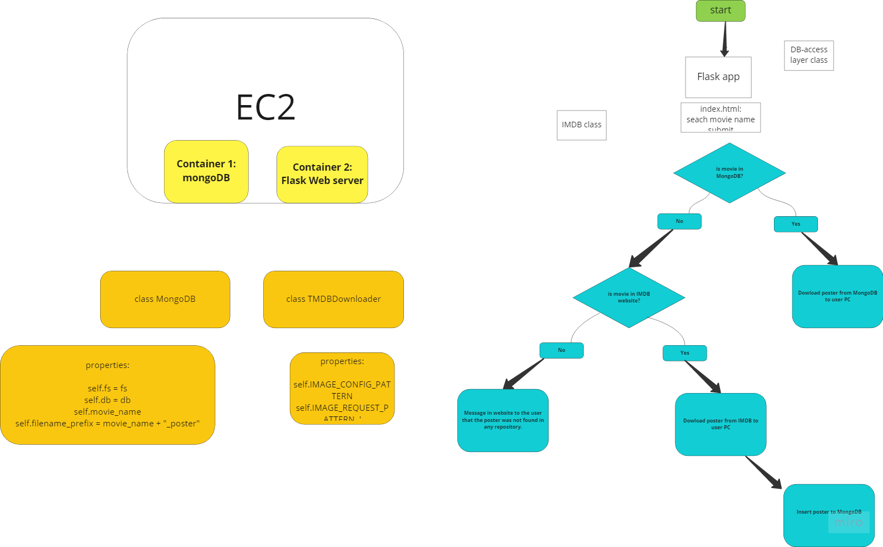
App Overview

Slide 4

Work-flow:
I divided the projects to smaller tasks:
Make the app download a movie from IMDB to my local PC.
Put the poster into MongoDB
Make the app work through one Docker containers
Make the app work using docker-compose
etc..

Slide 5

Demonstration

Slide 6
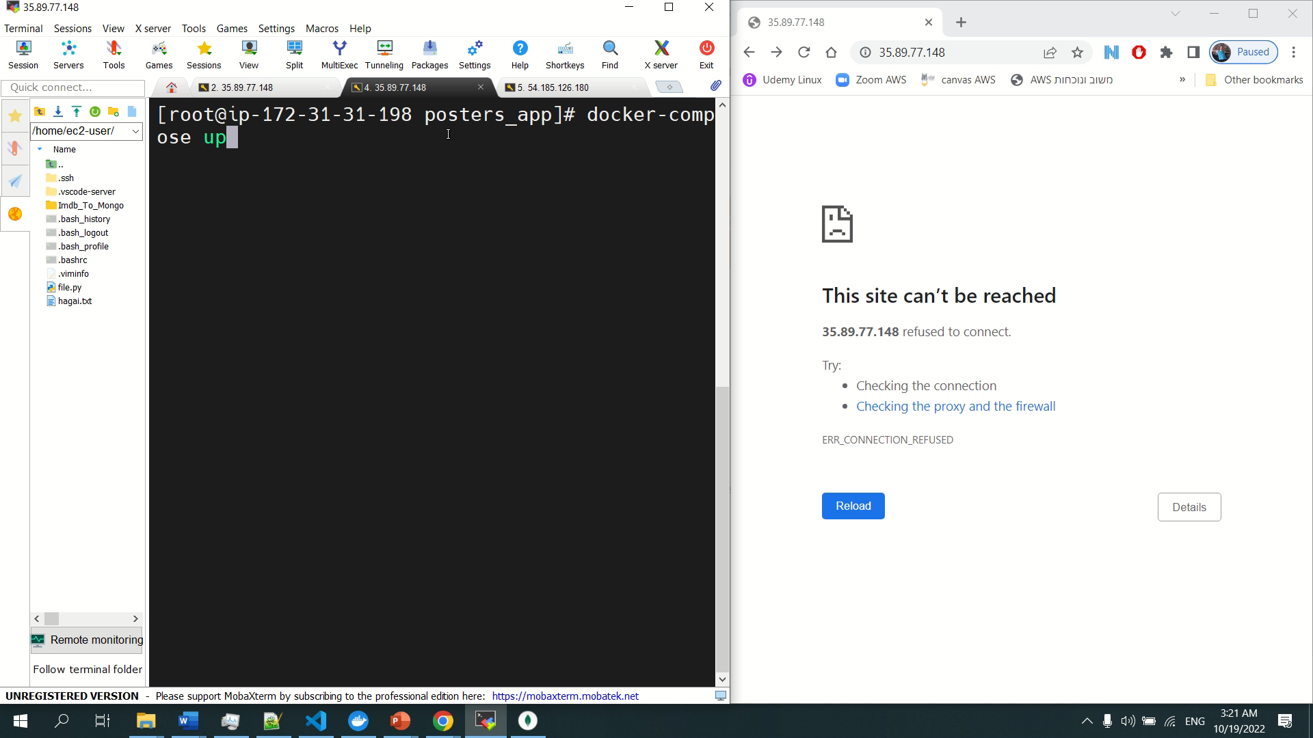
Demonstration Of MongoDB Memory Cache

Slide 7

Challenges
Accidently uploading the API KEY to Github
Facing new technologies: (Docker, Docker-compse, MongoDB)
Working on my own

Slide 8
If I Had More Time to Work On The Project
Automatic Deployment on EC2
through user data
Use best practices to transfer API-KEY to the Docker container
Improve Frontend design and UX.

Slide 9


